Slide 1
Modeling an Operations-Oriented Industry
Ric Zimmerman
Division 3, The Miami Valley Division, Mid-Central Region, NMRA
Notes:
There are any number of industries that might be used here. What I am about to show you is one industry that can provide a great amount of interest during a single operating session.

Slide 2
Would You like an Industry that Requires the Following Operations?
Incoming
Raw Materials – up to 20 cars per day
Coal/Coke: 5.3 hoppers (70-ton) per day
Limestone: 2.7 hoppers/gondola cars per day
Outgoing
Finished products: 2-4 box cars (50-ton)per day
Bulk product: 1-2 covered hoppers per day
Liquid product: 1-2 tank cars per day
Notes:
This industry can require the numbers and varieties of rolling stock that you see here.

Slide 3
The Sugar Beet Industry in the US
History of Sugar Beet Industry
The Process and Facilities to be Modeled
Equipment and Operations
Notes:
I present to you the sugar beet industry. An industry that encompassed a majority of the United States during the 19th nds 20th centuries.
Here is a list of the topics we will discuss today.
Although we are talking about the sugar beet process, the details and requirements are very similar to those of the Sugar Cane process/industry.

Slide 4
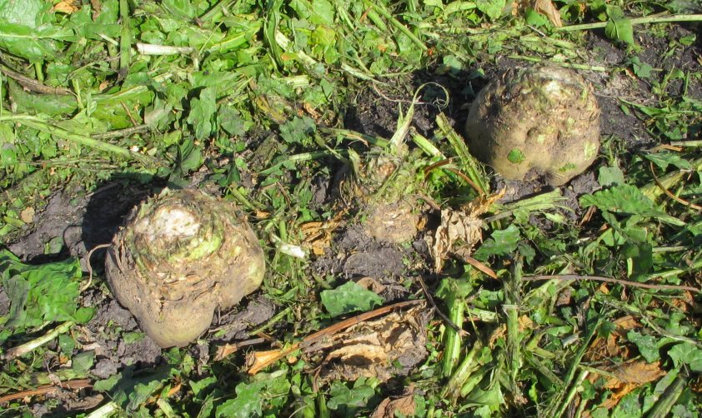
Sugar Beets
Notes:
Picture of a sugar beet still in the ground, but with the top greenery cut off.

Slide 5
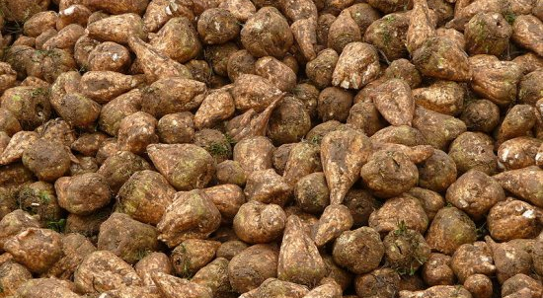
Sugar Beets
Notes:
Beets range in size from 12-18 inches.
Contain 6-10% sucrose.

Slide 6
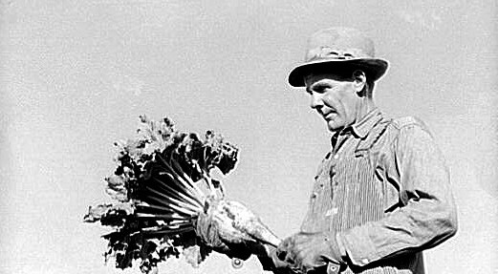
The Crop Farmer with Sugar Beet
Notes:
Beets range in size from 12-18 inches

Slide 7
Table of Contents
History
US Locations
Processing
Facilities
Loader
Mill Complex
Main Mill
Boiler/Lime Kiln
Storage -Warehouses/Silos
RR Equipment
Operations

Slide 8
History of Sugar Beets in the US
Began in mid-18th century Silesia, Prussia
Process of extraction introduced in US in mid-19th century
US Production started in 1879 in Alvarado, California
By early 1960s there were over 60 factories in 22 states, including Ohio
Notes:
Started in Germany (Prussia) in 1747. The first factory devoted to sugar opened in 1801.
Later the process was improved under Napoleon in France due to France’s inability to obtain sugar from the Caribbean sugar cane fields possessed by Spain and England.
A better process was created in Utah in the mid-1800s. The modern production process in the US began 1879 in California.
Sugar beets grow best in cool dry climates, and thus were grown and processed across the US.
By the early 1960s there were over 60 factories in 22 states – including Ohio.

Slide 9
States Where Sugar Beets are Processed
California -- Numerous
Colorado -- Brighton, Longmont, Loveland, Eaton, Ft Morgan, Ft Collins, Greeley, Johnstown, Ovid, Sterling, Windsor
Illinois -- Chicago - Bulk Terminal
Iowa – Mason City - Factory
Kansas -- Goodland - Kemp Factory
Louisiana – Godchaux
Montana – Missoula, Billings
Missouri -- St. Louis
Minnesota – Red River Valley
Nebraska – Scottsbluff
North & South Dakota --Henderson Factory
Michigan -- Bay City, Ottawa Lake
New York - Yonkers
Ohio – Findlay, Fremont
Oregon
Utah – Ogden, Salt Lake
Washington
Wyoming – Lovell, Wheatland

Slide 10
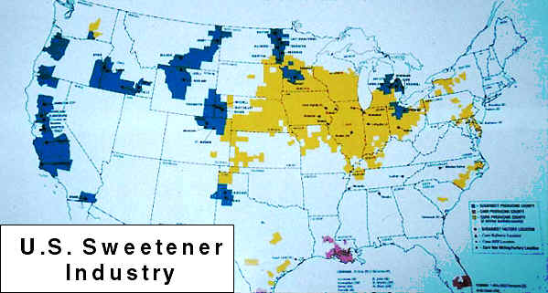
Sugar Beet Industry Circa 1958
Notes:
Although the map is slightly hard to read, it makes an important point about the kinds of sweeteners we use in the USA, and where they are grown. Sugar cane, a tropical grass with sweet, sugary juice in its stalks, is grown in Florida, southern Texas, and Hawaii (red on the map). Sugar beets, grown in areas shown in blue, are concentrated in the north, primarily because storing the beets after harvest is easier in cool climates. Beets provide an important sweetener for mid-latitude states and nations. Michigan sugar (under the Meijer, Pioneer and other local brands) comes primarily from sugar beets. Lastly, corn syrup, made from corn kernels, is becoming the sweetener of choice for many kinds of foods such as soda. Wherever corn is grown (yellow areas), high fructose corn syrup can be an important byproduct.
Sugar beets – BLUE
Cane – RED
Corn syrup - YELLOW

Slide 11
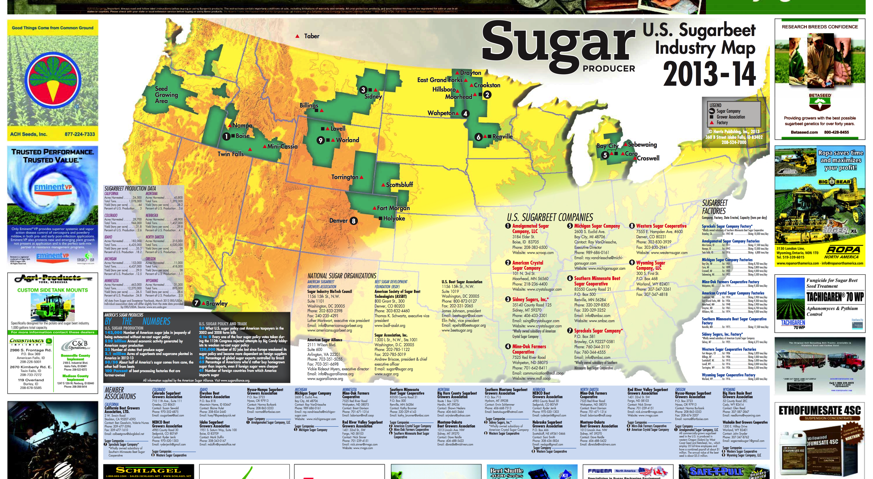
Notes:
Here is a map of the Sugar Beet Industry today

Slide 12
The Process
Harvesting
Transporting to Mill
Processing
Products
Shipping
Notes:
Personnaly, I believe that if you are going to model an industry, you first must have a basic understanding of how it functions.
Thus we will look at these steps in processing beets into pure sugar.

Slide 13
Harvesting
Usually begins in fall, September - January
Steps:
Topper removes foliage (used as silage)
Pinch wheel harvester (lifter) pulls the beets from the ground and dumps them into trucks
Notes:
First, we must get them out of the ground.
The beet RUSH starts in the early fall as temperatures get cooler.
TOPPER removes the green tops which are used as silage.
DIGGER pull the beets from the ground
PINCH WHEEL harvester lifts the beets to a conveyer that deposits them in a truck moving along side.

Slide 14
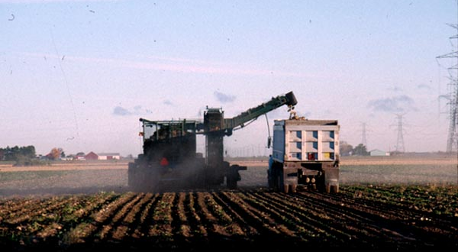
Harvesting
Notes:
Pinch Wheel Harvester in action.

Slide 15
The Process
Harvesting
Transporting to Mill
Beet Dump
Beets transported to dump via trucks
Weighed and samples taken
Beets loaded into railcars
Off-loading at the Factory
“Drop-Bottom” railcars unload on high lines
Other cars are unloaded manually or using crawlers
Piled for later use
Notes:
Once out of the ground the beets begin to turn their sucrose into starch, so it very important to get them to the factory as soon as possible.
The farm trucks take them to a centralized location or BEET DUMP for transport to the factory.
Trucks are weighed going into the dump and coming out to determine the actual weight of the product being shipped.
A Sample of each shipment is taken (6-8 beets) and sent to the lab to determine the sucrose content of the shipment. The farmer is paid based on the sample and the weight.
Beets are loaded onto railcars for transport.

Slide 16
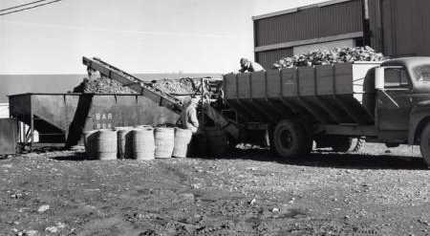
Loading at the Beet Dump
Notes:
Picture of beets being loaded into rail cars at the dump using a simple conveyer system.

Slide 17
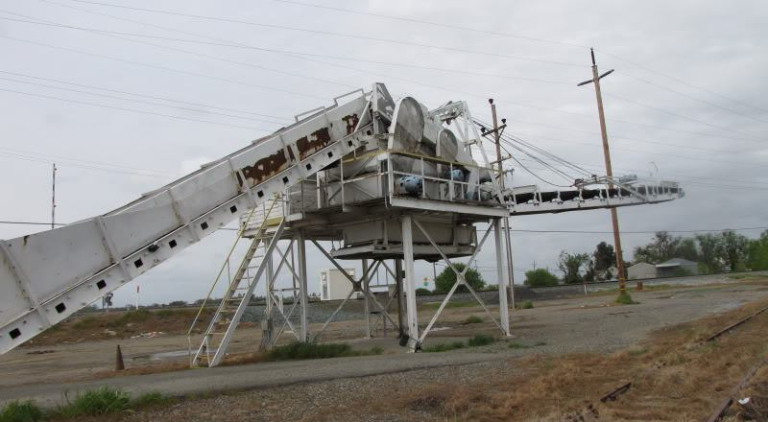
Beet Loader San Ardro, California
Notes:
Complex beet loader. During the loading process, debris such as rocks and dirt is shaken off the beets, and fall into a hopper at the top of the conveyor.
This debris is returned to the truck to be weighed during the out bound process.

Slide 18
Modeling a Beet Dump
Scratch build or kit-bash?
Drawings of San Ardo Beet Loader are available from RMC, Nov 2008¹
Simple conveyor system using kit parts
¹ Signor, John R, Modeling California’s sugar beet industry, Railroad Model Craftsman, November 2008, pages 58.
Notes:
SO HOW DO YOU MODEL A BEET DUMP?

Slide 19
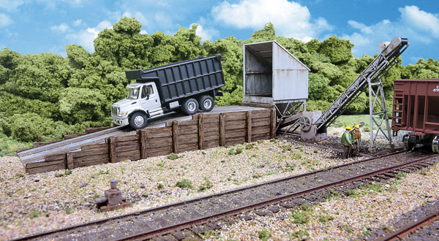
Simplest - Walthers Truck Dump (933-4058)
Walthers Photo

Slide 20
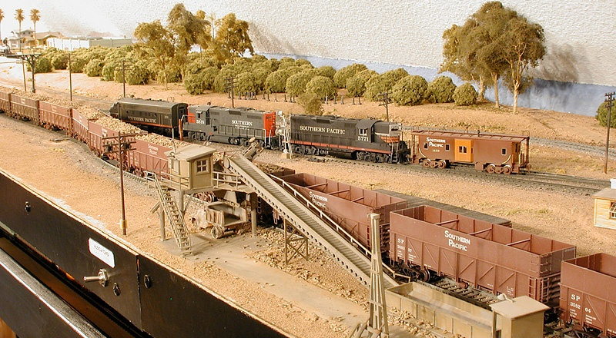
Challenging - Model Beet Loader
Source: Signor, John R, Modeling California’s sugar beet industry, Railroad Model Craftsman, November 2008, page 69.

Slide 21
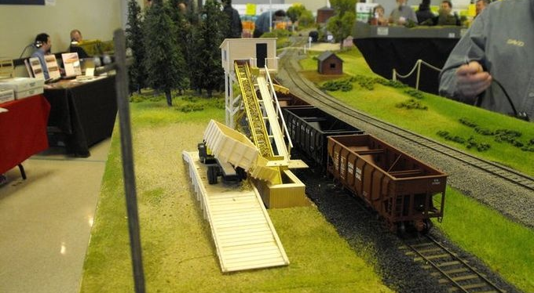
Beet Dump Model

Slide 22
Transporting the Beets to the Factory
Preferred method is with open-top cars such as gondolas and hoppers, but any available car-type can/would be used
Older drop-bottom gondolas and composite hoppers are preferred
Composite hoppers and gondolas are “easier” on the beets
Black, steel sided hoppers are not desired as the heat from elements destroys the sucrose
Notes:
During the “beet rush” railroads would use any, and all, rolling stock available.
Open top cars were preferred and composite cars with wood sides were favored over steel cars.
Black, steel hoppers were used, but the black, steel added heat from the sun’s radiation that broke down the beets and caused degeneration of the sucrose. The advent of aluminum (silver) hoppers helped to solve this problem.
Box cars were also used, similar to their use in transporting grains.

Slide 23
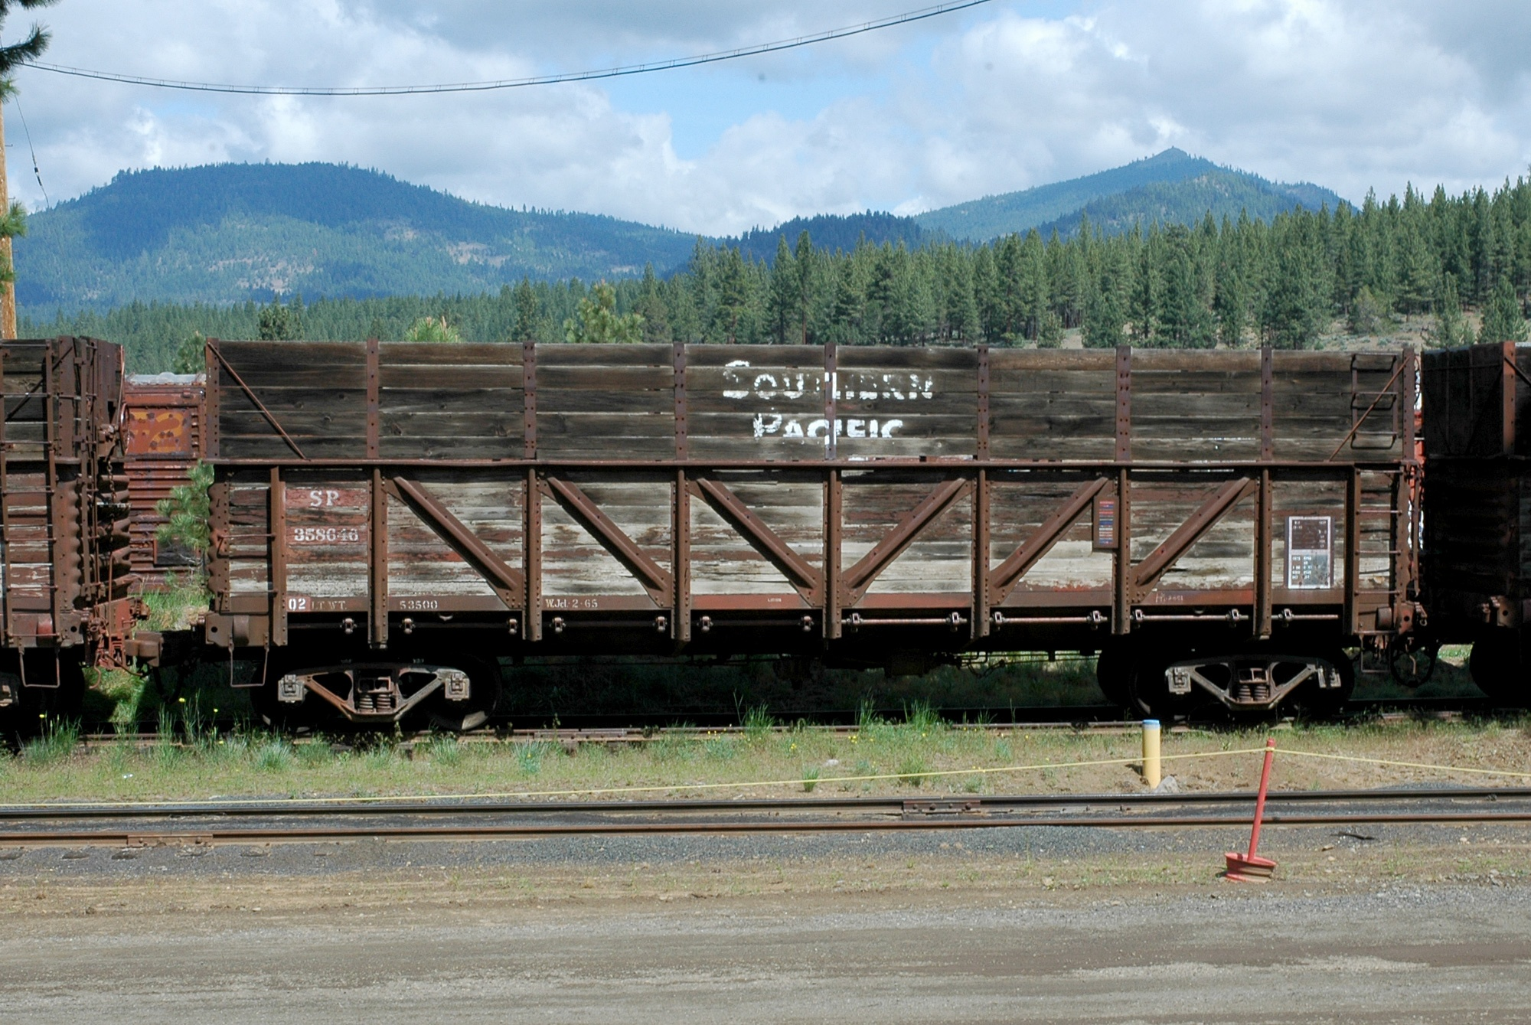
Transporting to the Mill (Beet Gondola)
Notes:
A typical composite, drop bottom gondola.
Many of these cars were “stored” for use during the beet rush in California. At the end of there service, they were not allowed to be used in interchange service due to their older, friction bearing trucks.

Slide 24
Potential Models
Drop bottom gondolas
Red Caboose has high-sided gondolas through Intermountain
Walthers, drop bollom gondolas
Composite hoppers
Athearn “Blue Box,” readily available at train shows
Notes:
WHERE DO YOU FIND SIMILAR MODELS?

Slide 25
The Process
Harvesting
Transporting to Mill
Beet Processing (simplified)
Carried into factory via flumes or sluices
Washed
Sliced into cossettes; long, thin strips (french fries)
Soaked in hot water in a diffuser to remove the sugar
“Spent” cossettes are dried and sold as animal feed
Sugar solution is purified and run through a centrifuge
Remaining solutions are sold as molasses
Sugar crystals are either bagged or sold as a bulk commodity

Slide 26
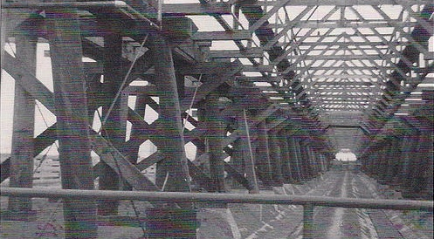
High Line & Flumes
Notes:
Basically a water filled ditch.
Beets float while the debris sink to the bottom.
Flumes were approximately 3 feet deep.
The highline was carried on trestles above the flumes.

Slide 27
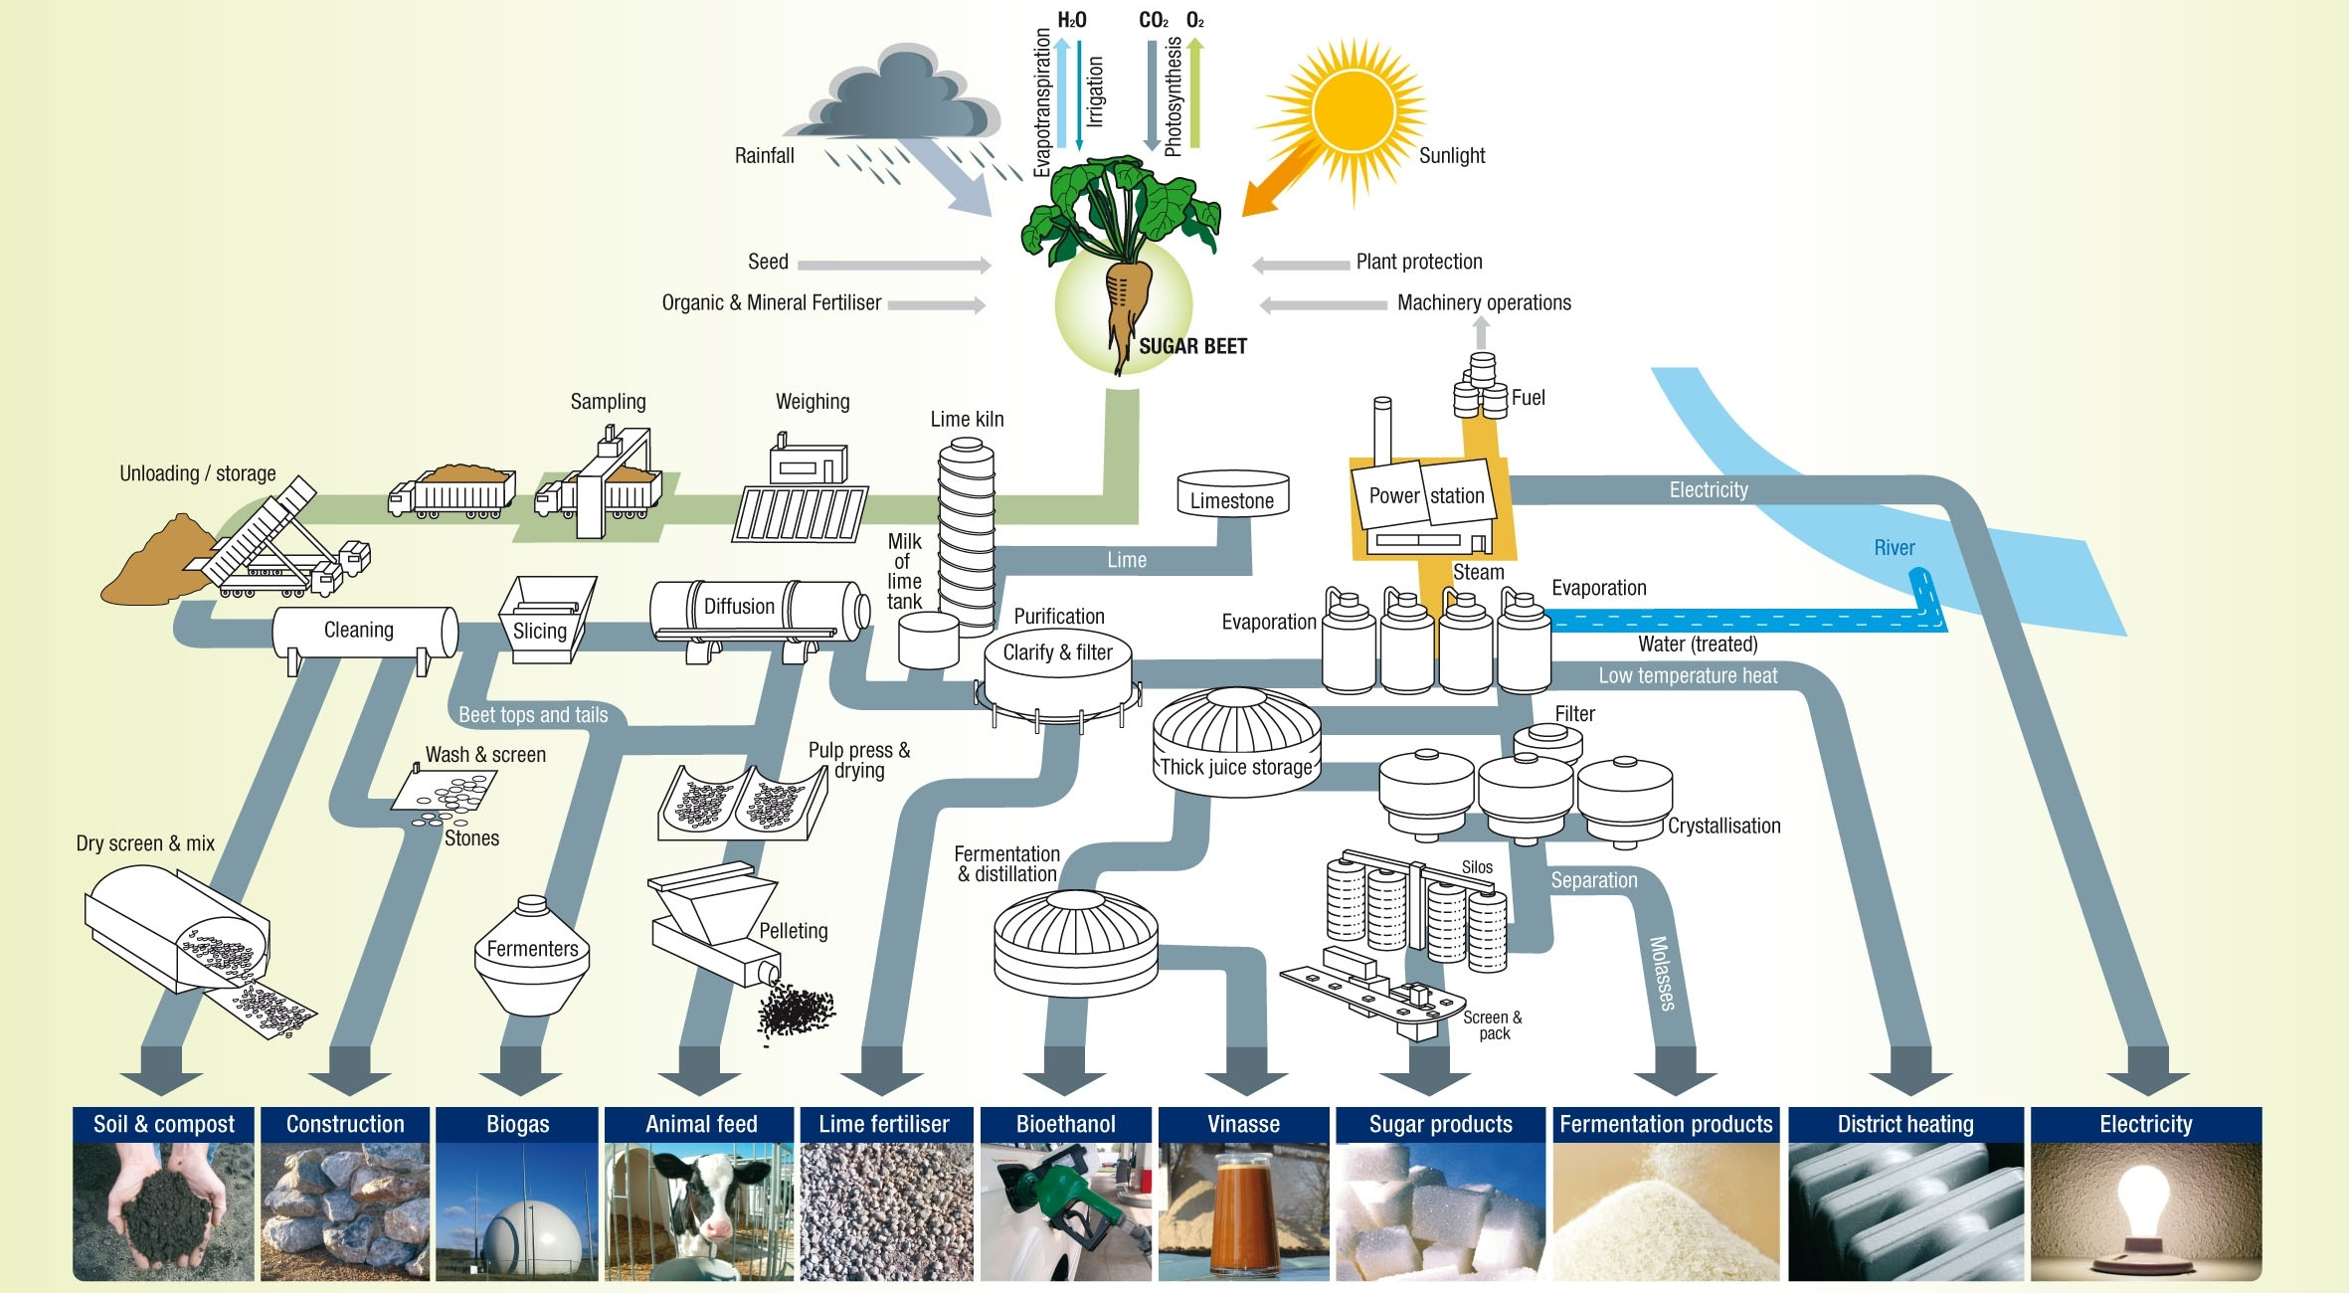
Sugar Beet Processing
Notes:
This is a schematic of the sugar beet process.

Slide 28
Process at the Factory
Moved from the storage piles via sluice or flumes
Washed and sliced into cossettes
Cossettes pass through diffusers where sucrose is extracted using hot water
Lime and CO₂ used in the extraction to purify the Syrup.
Evaporation removes excess water
Sugar syrup (raw juice) is processed through carbonatation to remove impurities
Juice is the crystalized in centrifuges
Notes:
Cossettes are similar in size and shape to “French fries”

Slide 29
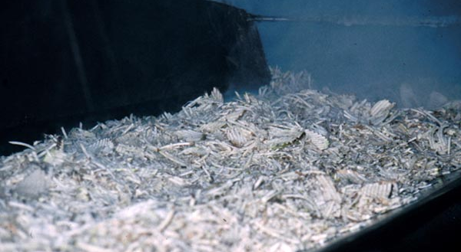

Beet Cossettes
Pellets
Notes:
Once the cossettes have released their sugar content, they are dried and molded into pellets with are used for animal feed.
Beside sucrose, sugar beets are high in other nutrients which make the cossettes a valuable feed source for livestock.

Slide 30
Process at the Factory
Moved from the storage piles via sluice or flumes
Washed and sliced into cossettes
Cossettes pass through diffusers where sucrose is extracted using hot water leaving raw juice
Sugar syrup (raw juice) is processed through carbonatation to remove impurities
Lime and CO₂ used to extract and purify the Syrup.
Evaporation removes excess water (thick juice)
Juice is the crystalized in centrifuges
Notes:
Diffusers are apparatus in which hot water is passed over the cossettes causing them to release the sugar – creating RAW JUICE
The used cossettes, or pulp, exit the diffuser at about 95% moisture but low in sucrose. This is dried and pressed into pellets.
The carbonatation process removes impurities using milk of line usually created on site. This leave THIN JUICE
The thin juice is sent to Evaporators which remove much the excess water leaving THICK JUICE, which enters the crystallization process in which the syrup is boiled in a vacuum leaving a very tick syrup called massecuite (“Cooked Mass”).
Massecuite is run through centrifuges extracting sugar and creating crystals of pure sugar.

Slide 31
Process at the Factory (Cont)
Once crystallization has taken place white sugar is bagged or sent to bulk storage
Juice that is not fully processed is reprocessed
A final by-product is molasses
Pulp from dried, spent cossettes in the initial stages of the process is pressed into pellets, and bagged as animal feed
Stored in warehouses or silos
Notes:
Sugar, having been extracted and crystallized, the remaining syrup is returned to the process to be reprocessed.
One final product of the process is the syrup which does not get processed is sold as molasses.
THERE YOU HAVE IT. NOW HOW CAN WE MODEL IT?

Slide 32
Modeling the Industry (Mill/Factory Complex)
Actual sugar beet factories are huge requiring larger amounts of space
Numerous buildings are required for variety of functions: Mill, boiler house, warehouses, administration, etc.
Using selective compression the industry can be modeled in your available space.
Notes:
Real sugar beet factories are huge with numerous buildings required for variety of functions: Mill, boiler house, warehouses, administration, silos, etc.
By using selective compression it can be modeled.
Here is an example of the actual size of a factory.

Slide 33
Brighton Factory - Approximate Dimensions
Over 1180 feet from silos to end of the warehouse
Factory is ~ 275’ long by ~50’ wide
Warehouses are ~ 300-450’ long by 55-75’ wide
Boiler House ~200‘ x 85’
Silos are up to 130’ tall by 32’
From Google Earth
Notes:
This is an aerial shot of the factory at Brighton, Colorado.
Using the measurement tool in Google Earth, we can get the approximate dimensions of this facility.
SO HOW MUCH SPACE TO HAVE TO GIVE OUR FACTORY COMPLEX?

Slide 34
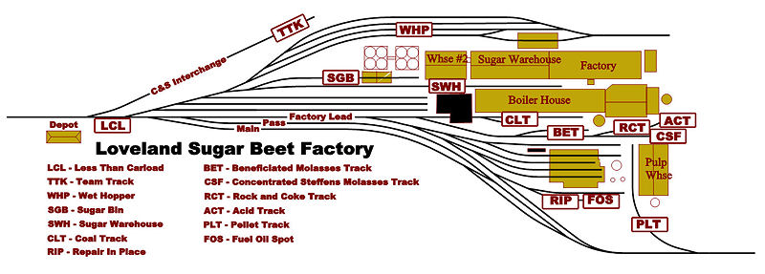
Map of the Loveland Colorado Factory
Source: George Booth, Model Railroads by George Booth - The New Great Western Railway (late 2009 to present)
Notes:
This is a schematic of George Booth’s Great Western Sugar Company factory at Loveland Colorado.
George models the Great Western Railroad which supported the GW Sugar Company.
George’s Loveland Factory is 18x6 feet in HO scale.
But we can get smaller.

Slide 35
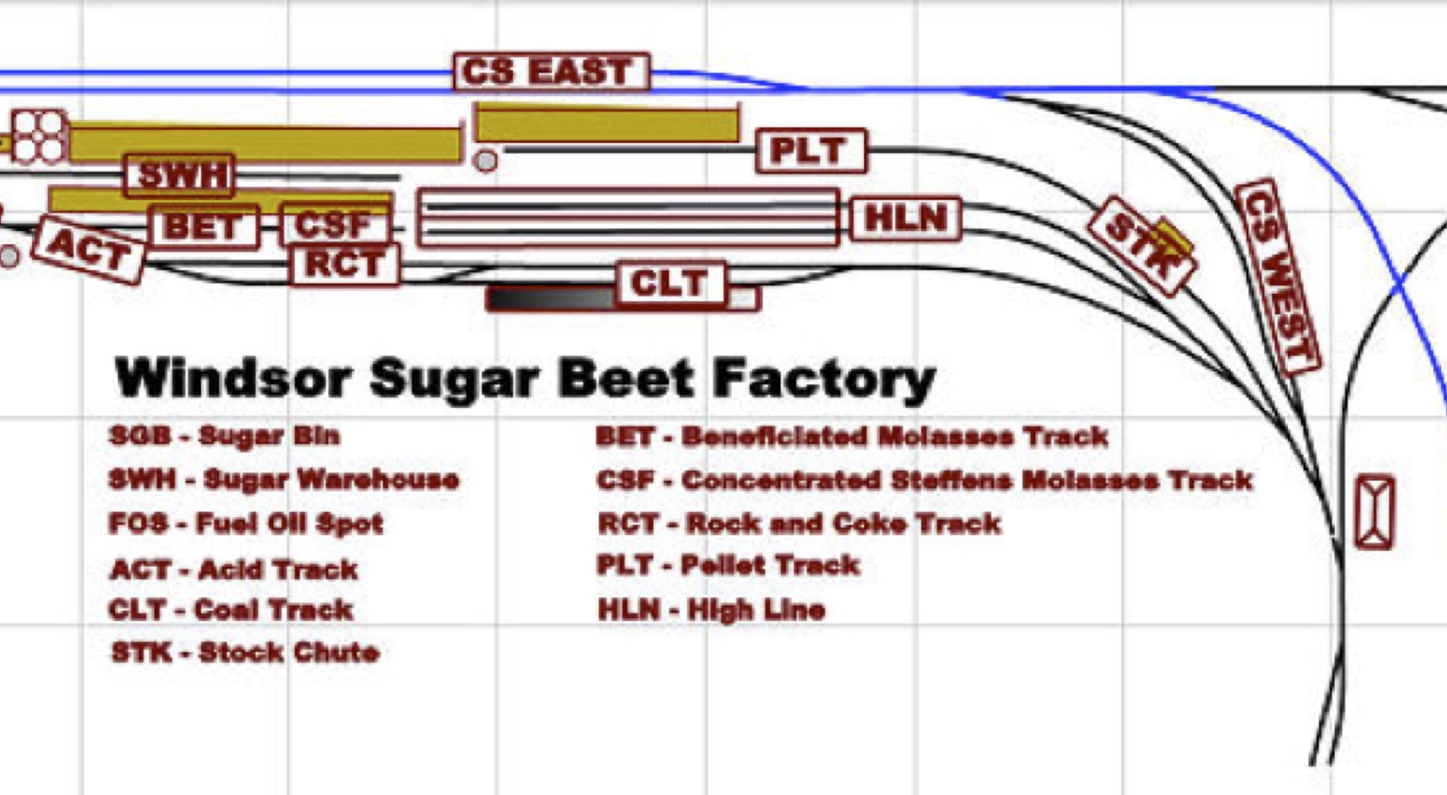
Windsor Colorado
Source: George Booth, Model Railroads by George Booth - The New Great Western Railway (late 2009 to present)
Notes:
George Booth’s Great Western Railroad
This is a schematic of his Windsor Colorado factory an it fitts into an area of about 7 ft X 2 ft
WE WILL SEE MORE VIEWS OF THIS MODEL

Slide 36
Sugar Beet Factory at Brighton on My Colorado Central
Notes:
This is the area used for my model of the Brighton factory on my freelance Colorado Central Railroad.
It measures about 5 ft X 4 ft in HO scale

Slide 37
How Do We Do It?
Look for pictures of a facility
Determine you available space
Plan your track plan and building space
Make or find representative models
Start to create.
Examples…
Notes:
Look for pictures of a facility.
Determine you available space.
Plan your track plan and building space.
Make or find representative models
Start to create.
Examples…
Since I chose to model the north-central region of Colorado along the UP Wyoming Division. The Brighton factory seemed to be a logical choice.

Slide 38
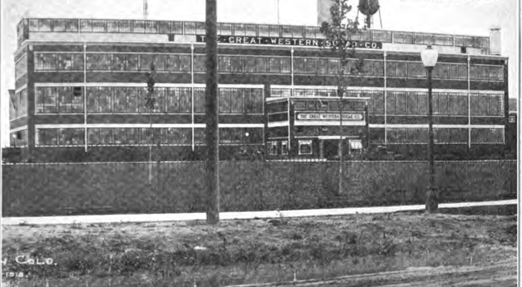
Great Western Sugar Co. Brighton, Colorado
Notes:
Built in the early 20th century (1916)-17) as Great Western’s shown place due the proximity to Denver.

Slide 39
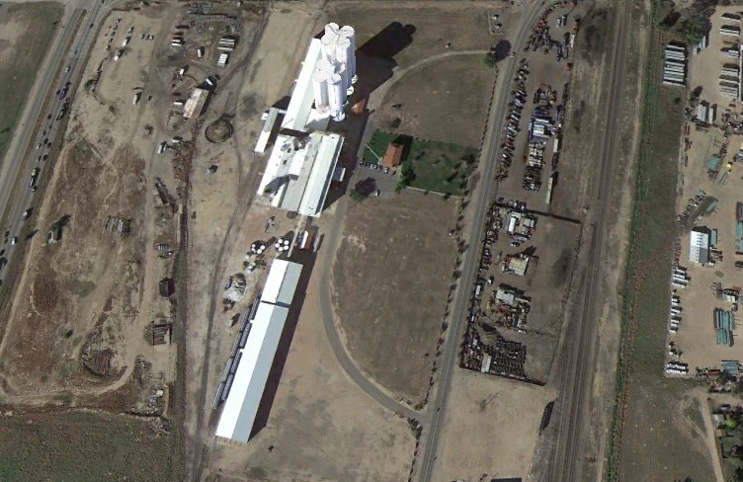
Aerial Shot of the Brighton Factory Today
From Google Earth
Notes:
Point out the following:
Factory
Warehouse
Sugar house
Boiler house
Siloes
Water tower
Administration building
High Line area
Union Pacific mainline

Slide 40
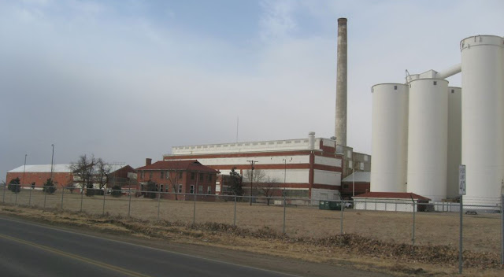
Brighton Factory Looking SW (1977)

Slide 41
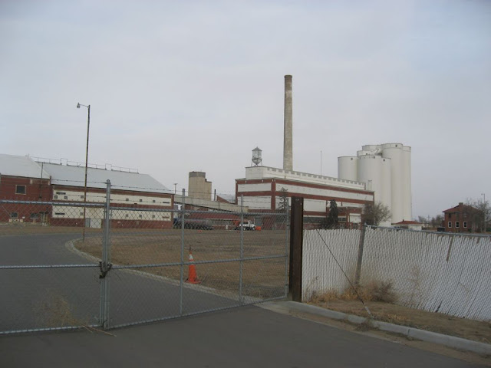
Looking NW (1977)

Slide 42
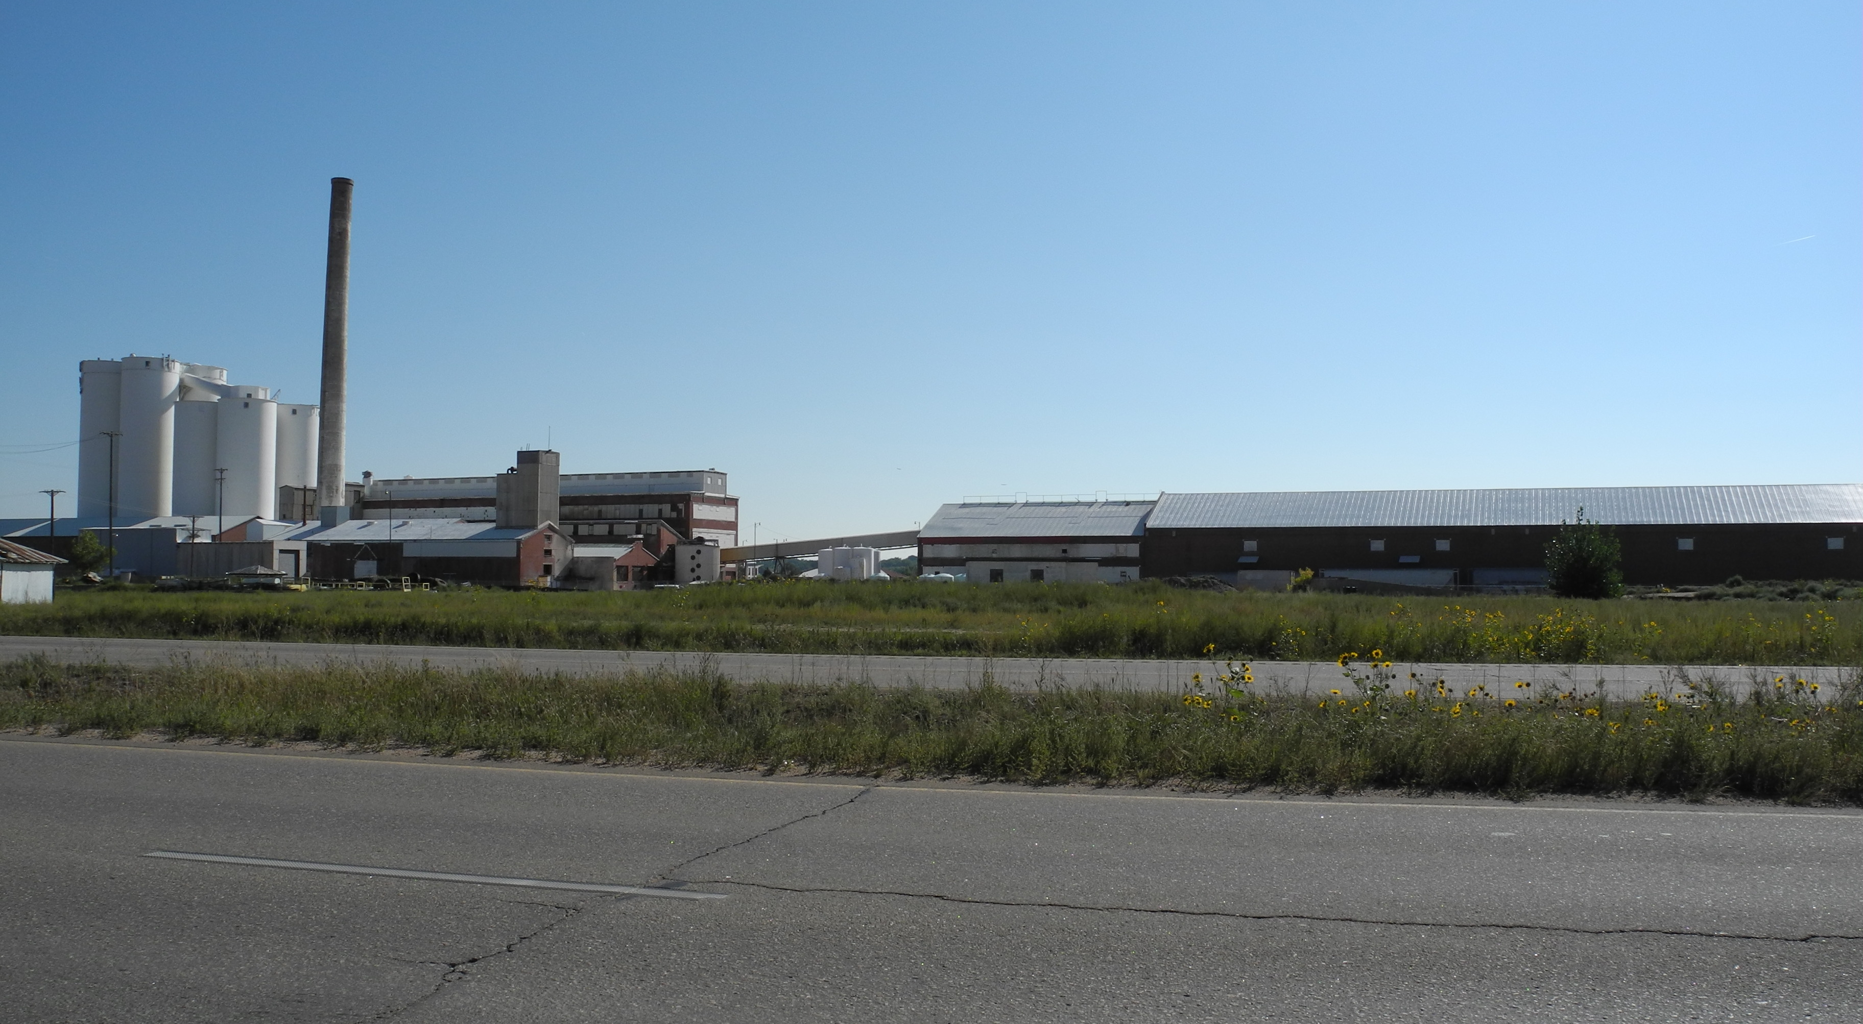
Brighton Factory, Today Looking NE Sept 2014

Slide 43
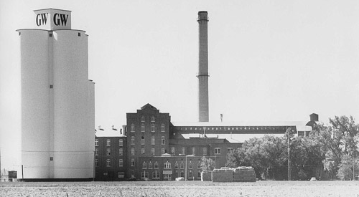
Great Western Factory, Scotts Bluff Nebraska
Notes:
Observe the details of the factory.

Slide 44
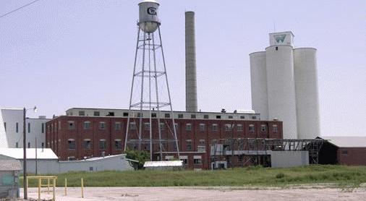
GW Sugar Company Factory, Ft Collins, Colorado
Notes:
Similarities to the Brighton factory.

Slide 45
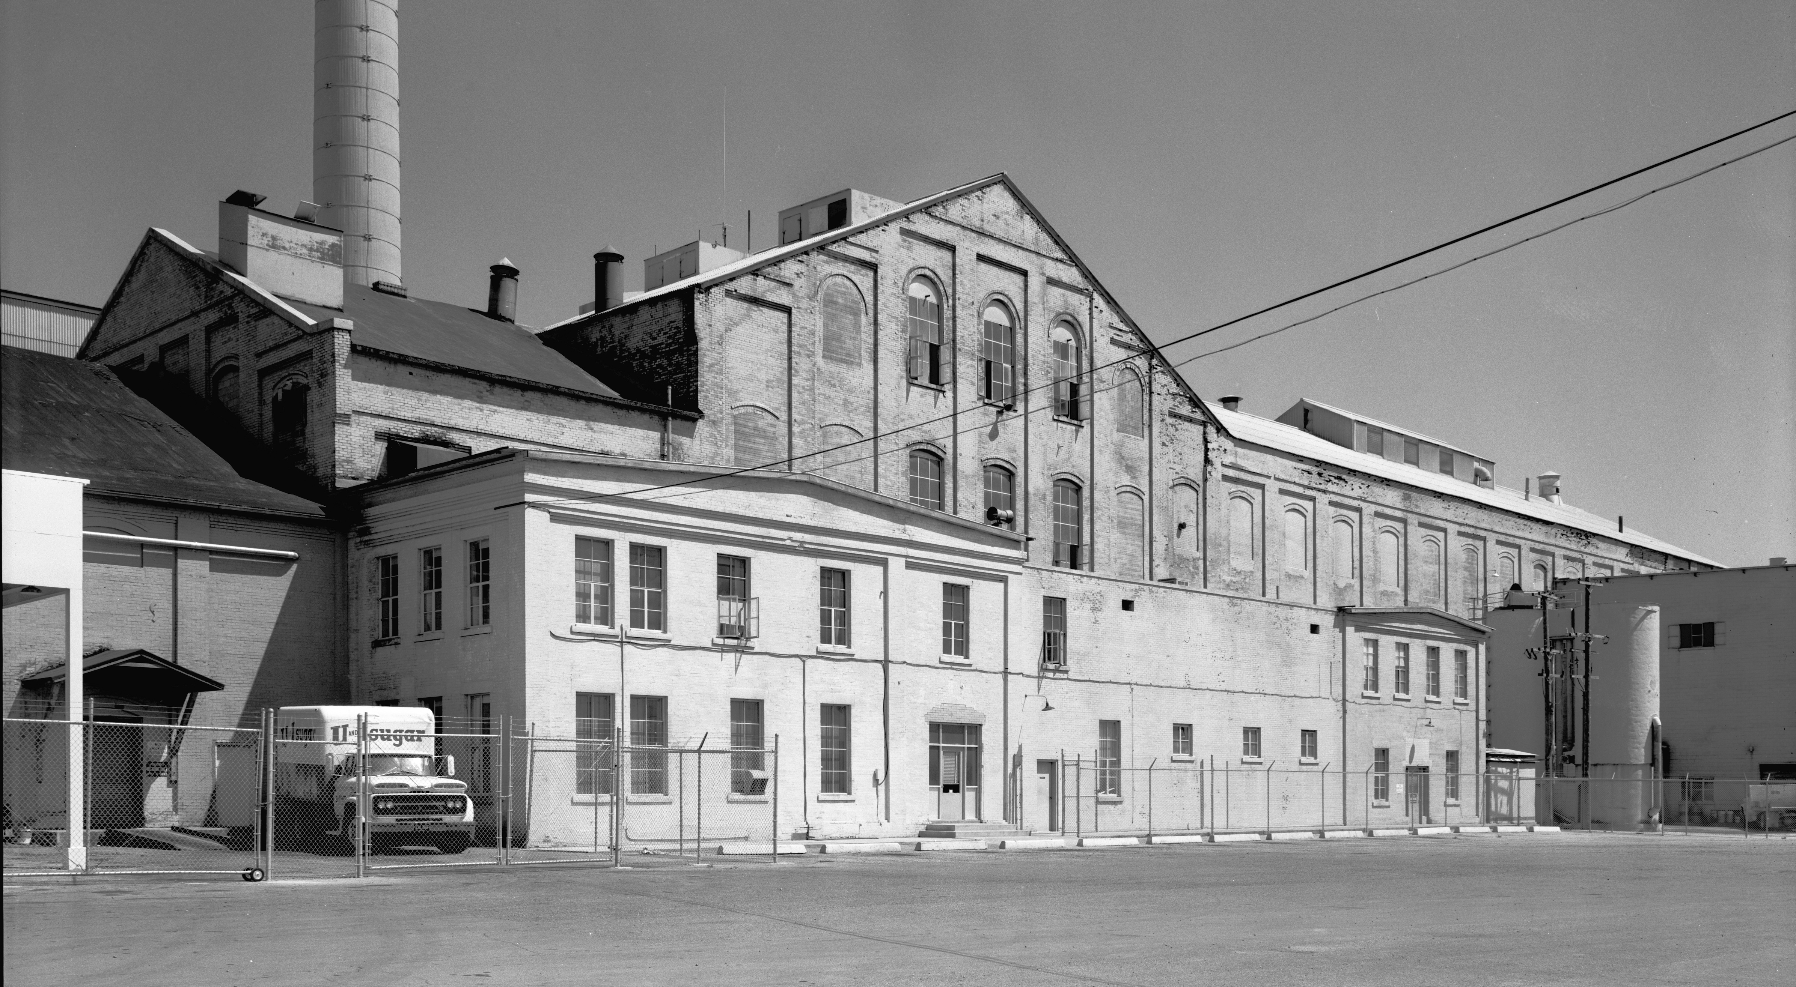
GW Sugar Company Factory, Garland, Utah
Notes:
Note the architecture of the building

Slide 46
How to Model the Factory
Factory
Sugar Mill complex can be scratch-built or kit-bashed from available kits
Size of the factory is dependent on space available
Use background pictures if space is not available
Warehouse kits are also available, or easily scratch-built
Kiln and Boiler House easily scratch-built or kit bashed
Notes:
You have picked out your factory now apply some additional planning to determine how to represent it.
Are you going to scratch build it or kit-bash it
OR you can take the easiest way – simple kit.

Slide 47
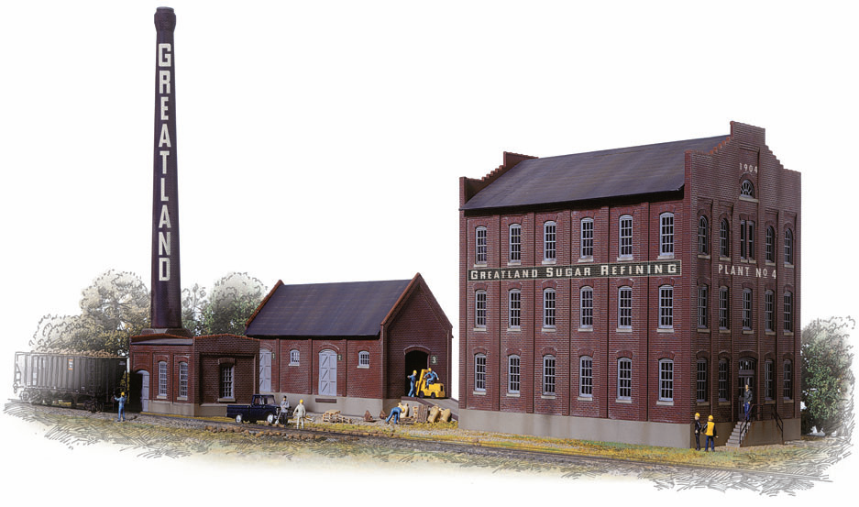
Walthers Sugar Beet Mill (933-3092)
Walthers Photo
Notes:
This is a European design, originally Pola

Slide 48
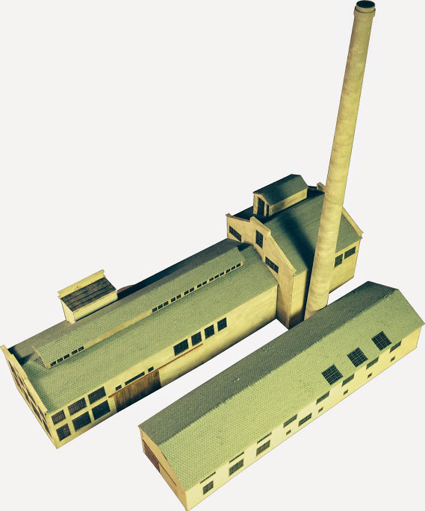
Beet Factory – N-Scale
Notes:
Bergan Laser

Slide 49
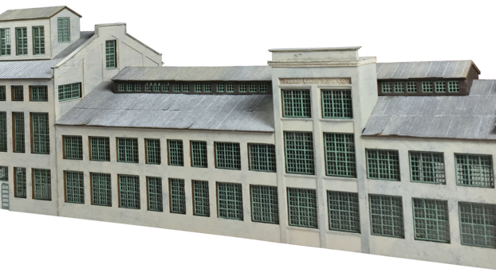
Bergen National Laser
Used with Permission
Notes:
Fairly expensive, but a good representation.

Slide 50
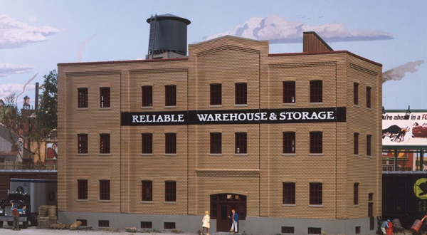
Walthers Reliable Warehouse & Storage (933-3014)
Walthers Photo
Notes:
Similar architecture to Garland or Scotts Bluff

Slide 51
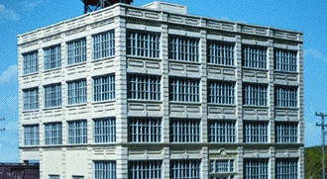
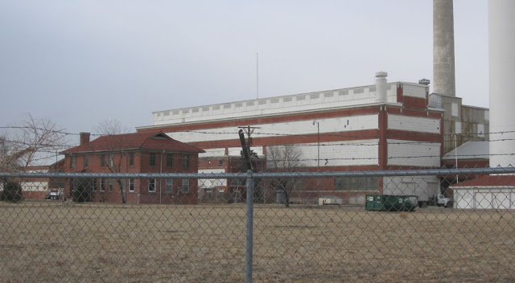
Walthers Hardwood Furniture (933-3044)
Walthers Photo
Notes:
Many windows, similar to the Brighton factory
Most of the factories followed a similar plan and were three stories

Slide 52
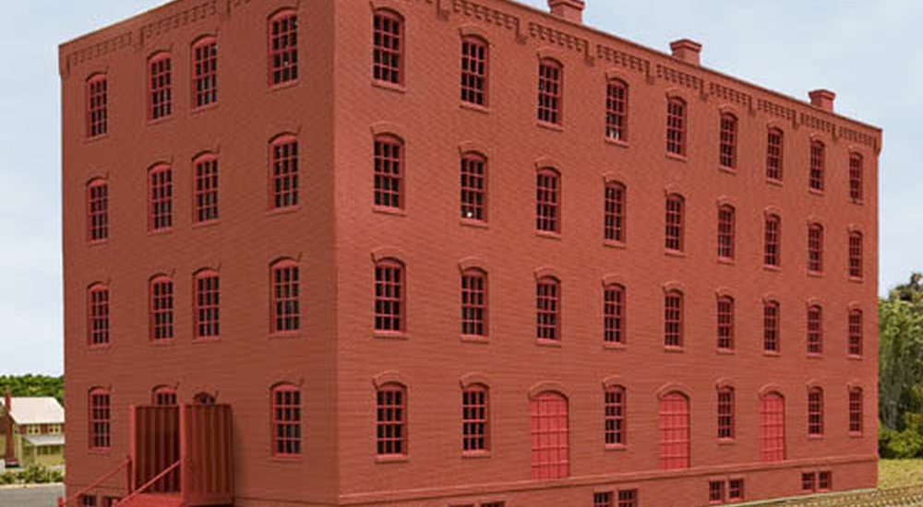
Atlas Middlesex Manufacturing (ATL-721)

Slide 53
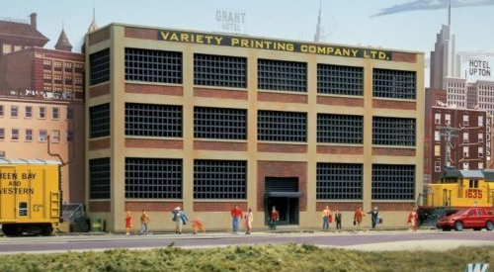
Walthers Variety Printing (933-3161)

Slide 54
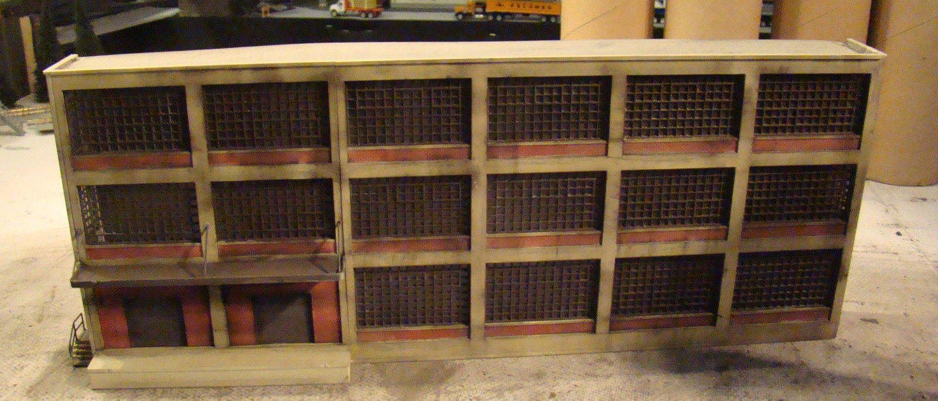
Walthers Armstrong Electric Motors (933-3172)

Slide 55
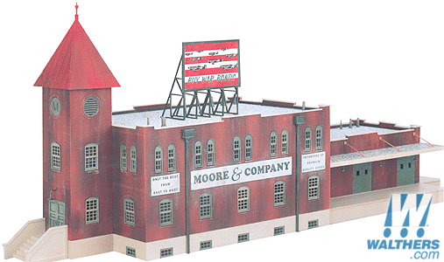
Life Like Moore & Company Available (Sometimes) Via e-Bay
Notes:
Interesting kit since it is modular (three pieces)

Slide 56
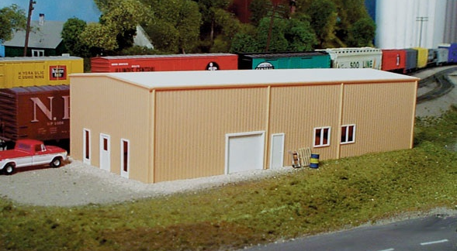
Pikestuff Prefab Warehouse (541-4)
Walthers Photo
Notes:
Warehouses built in the early 20th century were usually brick, but this warehouse will still due nicely.
Add additional windows and freight doors.
Use two end-to-end or stacked.

Slide 57
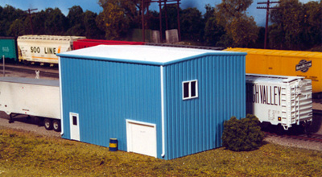
Pikestuff Yard Office (541-16) Potential Boiler House?
Walthers Photo
Notes:
Remove the windows and add a few extra feet to the base

Slide 58
Silos, Stacks & Water Towers
Silos are the skyscrapers of the prairie – large and imposing structures
PVC piping proves the best solution
Various diameters allow the modeler to fit silos to the space available
Smoke stacks can be scratch-built or commercially available
Water towers are required to provide the water pressure necessary to operate the factory
Notes:
Silos should be taller than any other part of the facility. 2 & 3 inch PVC pipe makes best silos. Height should be around 12 inches with a Head House.”
Walthers sells a pair of brick stacks
Numerous water tower kits available

Slide 59
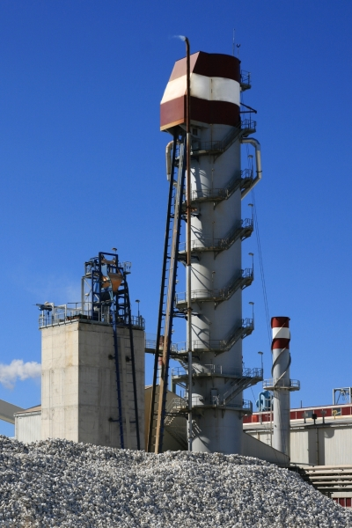
Vertical Lime Kiln
Lime is required to remove impurities from the sugar syrup
Also produces CO₂ used in the process
Kiln Requirements:
Limestone
Coke
Model using 1-1.25” PVC
Notes:
Lime was often produced on-sight in a kiln
Limestone is “cooked” with coke (pure carbon) to produce “milk of lime” and CO2,
1 or 1.25 inch PVC tubes can be used

Slide 60
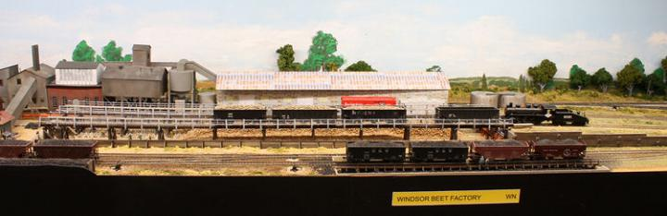
High Line Models
Best if scratch-built
Windsor Colorado High Line
George Booth Photo
Notes:
High lines add a neat touch to your model.
The following pictures show the work of George Booth and provide examples of what to look make.

Slide 61
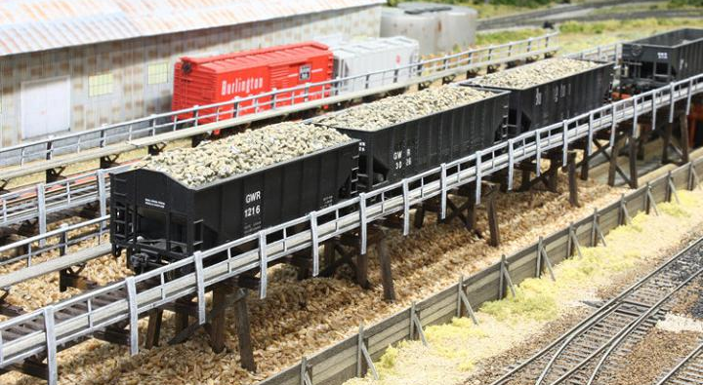
Windsor High Line
George Booth Photo
Notes:
This is the Windsor high line in its finished form.

Slide 62
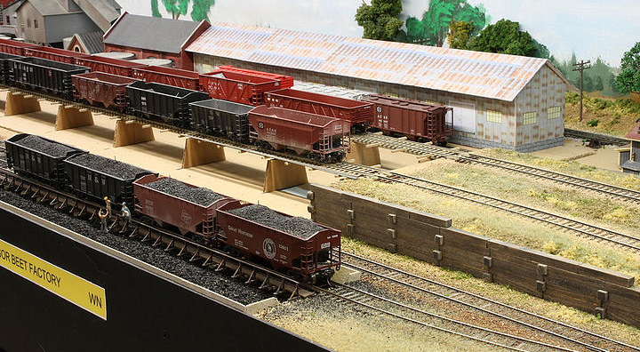
Preliminary View of High Lines
George Booth Photo
Notes:
George had a pretty good idea of what he wanted, but building a mock-up proved its value

Slide 63
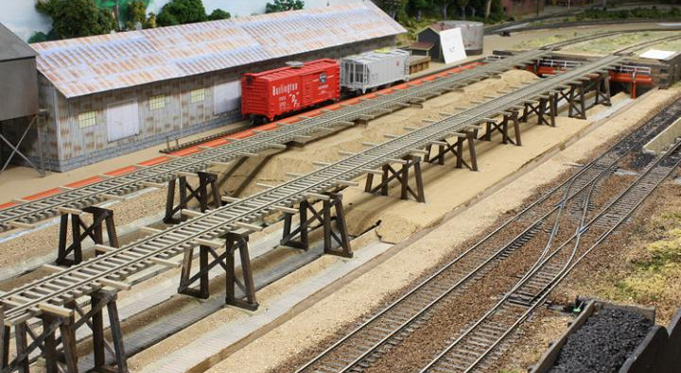
Early Construction of the High Line
George Booth Photo
Notes:
High Line is 42 inches long; a lot of bent construction.

Slide 64
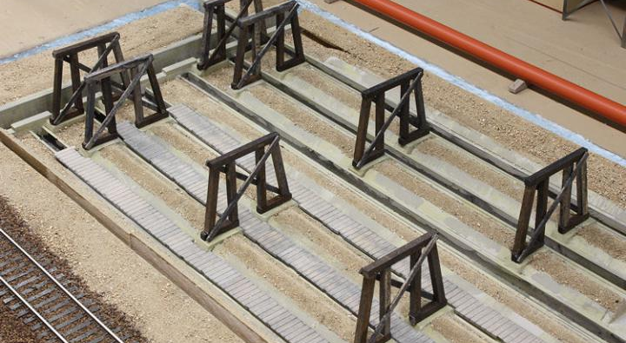
Flumes and Trestles
George Booth Photo

Slide 65
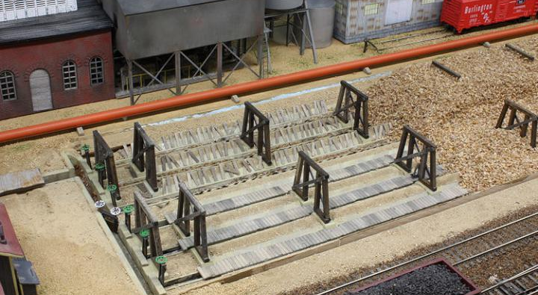
High Line (Left) Ready to Receive
George Booth Photo
Notes:
I’ve added some head gates on each flume. The three in the front are closed, blocking any water flow. The three in the rear are open allowing beets to flow into the sluice ways and into the factory. The gate with white handles is to keep the beets going the right direction. Once I get some figures positioned along the flumes, I will add some diagonal bracing to the rear bents. There are 80 boards across each flume.
The 4x12 fence will hide the front piece of wood and the blue edge of the Styrofoam.
Note the “machinery” under the corrugated building in the background. I wanted some lumpy looking things under there, mostly hidden from view. The majority of things are Athearn Blue Box engine motors and gear box pieces parts, painted dingy grey. They look kind of like blowers and vents. If you squint.

Slide 66
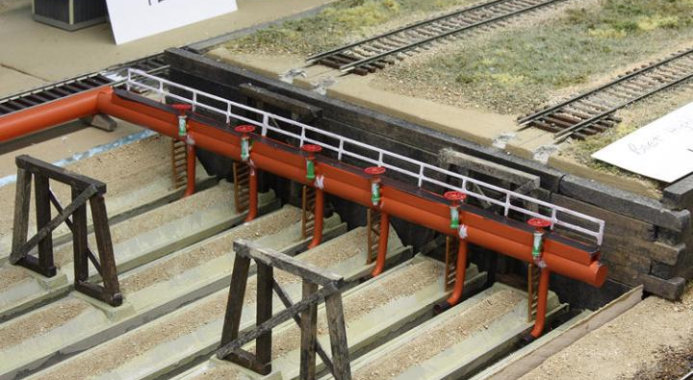
Water Inlets and Control Valves
George Booth Photo
Notes:
The flumes use a lot of water so he used “modelers license” to imagine how the water got there. A nice 3’ pipe comes from the factory and each flume has its own valve to control water flow. The valves are from the scrap box – fire hydrants and brake wheels. The J-shaped pipe underneath is large gauge solder. The supports are fire escape pieces. Plastruct supplied the walkway railing..

Slide 67
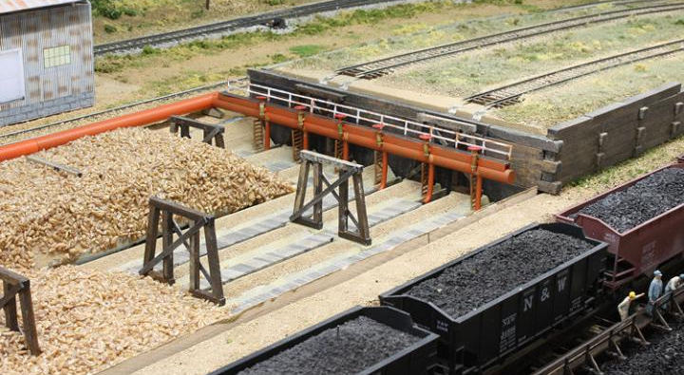
Water In-Flow
George Booth Photo
Notes:
In operation, workers place boards over the flumes to cover them while beets are piled on top. Once the beet hopper unloading is finished, water is turned on and boards are removed one by one to allow the beets to fall into the flumes. This end had boards over all the flumes. The back set is the last to be removed for the completed pile. The front set is longer since the front pile is just being dumped.

Slide 68
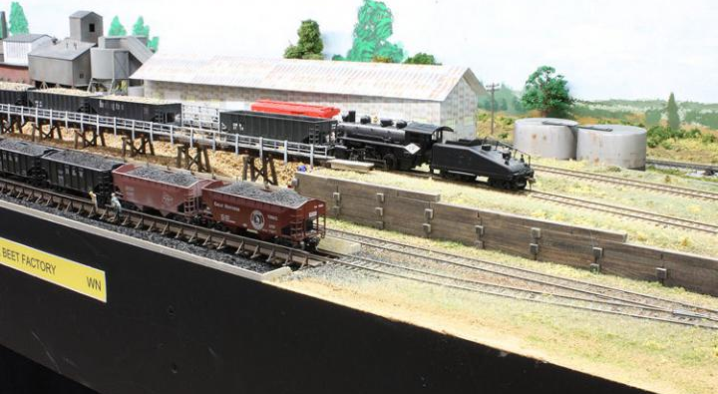
Windsor High Line Loading
George Booth Photo
Notes:
The entrance to the highline is a ramp up to the trestle level, on a curve like the prototype. Shown here is GWR No. 101 pulling a hopper after being emptied. I think my next project will be to paint and decal some of the steam engines I’ve been collecting. This is a Bachmann 0-6-0 that I modified with a working front coupler. The GW had two of these switchers with slope-back tenders.

Slide 69
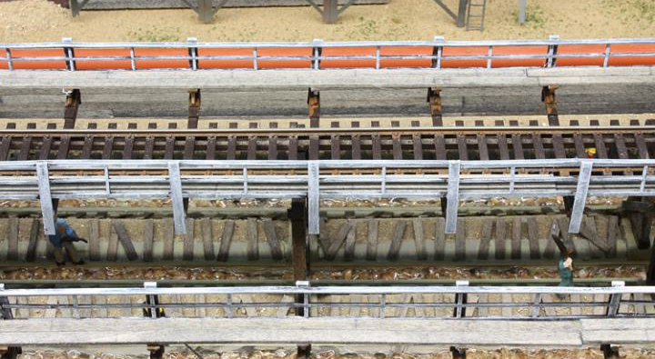
Floating Beets in Flumes to Factory
George Booth Photo
Notes:
Here is a close-up of the flumes. This shows the water flowing and moving beets from the rear pile into the factory. The boards that covered the flume when the beet were unloaded are stacked along the flumes. The orange pipe in the rear is the 3’ diameter water pipe to the inlets. The beets were covered with acrylic glaze to get the wet effect.

Slide 70
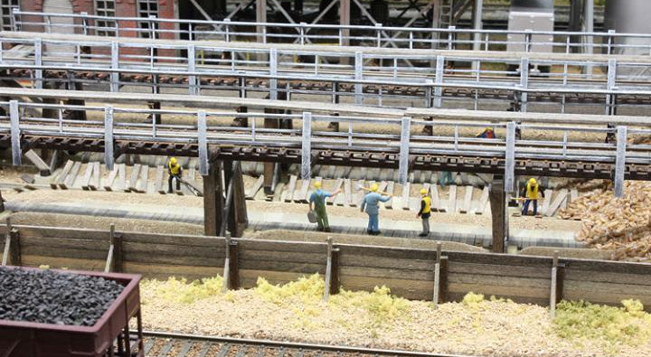
Cleaning the Flumes
George Booth Photo
Notes:
Here is more detail under the trestle. Some of the workers are poling the beets along the flumes to keep them moving. Beets are recalcitrant beasts and need constant herding. The three loafers are standing on the covered front flumes and better watch out for falling beets.

Slide 71
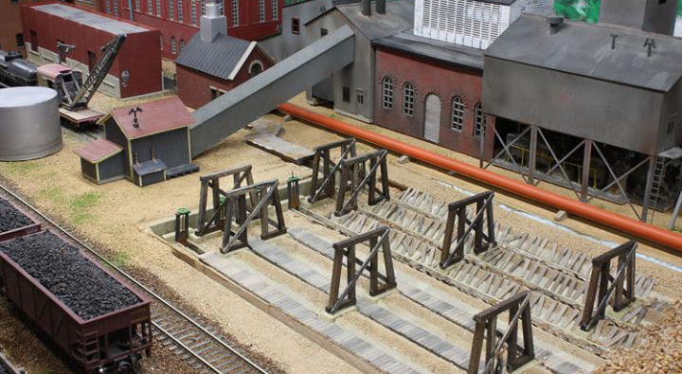
George Booth’s Windsor Beet Factory
Notes:
This end of the highline has an assortment of buildings to give the impression a busy place. The gray metal buildings are old Suydam mine buildings from my 1978 era layout (nothing much goes to waste). They represent a lime kiln and beet pulp processing facilities. Most of the real factory buildings were brick but modeler’s license goes a long way.
The sluice way has a rusted corrugated metal cover over it – we don’t want any workers falling into the sluice and getting processed into Soylent Green. There will also be a railing in front of the sluice at the end of the flumes. The building with the slanted conveyer sends the limestone and coke to the kiln.

Slide 72

Beets Diverted into Factory
George Booth Photo
Notes:
This is the other end of the flumes with head gates and a diverter valve to direct the beets. Corrugated steel covers the sluiceway leading into the receiving building. Jack the Flume Master stands by the fence making sure all is going smoothly. I think I may need a ladder or stairway at this end to get up to the walkway. The building in front is the conveyer building for coke and limestone. Small piles of each need to be added here. The mobile crane to the left helps load the material.

Slide 73
High Line Discharging Beets
George Booth Photo
Notes:
The final phase was adding the railings and walkways on the trestle structure. Even though they are not a duplicate of the actual structure, I think they serve the purpose of keeping workers from falling into the flumes. The railings were assembled from Plastruct parts glued to the uprights. A grey undercoat was dry brushed with white to give a weathered appearance. The walkways are 4x12 strip wood stained with India ink and alcohol.

Slide 74




Locomotives
Notes:
Almost all factories were supported by older locomotives acquired from railroads or leased equipment.

Slide 75
Products
Inbound –
Sugar Beets
Coal, Coke
Limestone
Packaging supplies
Out Bound –
Bagged or Bulk Sugar
Molasses
Bagged or Bulk Pulp

Slide 76
Modeling Sugar Beets
Bulgur wheat
Anise seeds
Small packaging material
Certain varieties of small grain rice
Cracked wheat

Slide 77


Example: Bulgur Wheat
George Booth Photo

Slide 78

Example of Anise Seeds

Slide 79

Sesame Seeds

Slide 80
Shipping
Before 1960
Most shipping was handled by rail, both inbound and outbound loads
After 1960
Beets delivered to the factory by truck
Outbound loads mostly handled by rail

Slide 81
Typical Carload Averages (35,000 Tons-Per-Year - 1958)
Incoming
Beets – 20 cars per day
Coal/Coke: 5.3 hoppers (70-ton) per day
Limestone: 2.7 hoppers/gondola cars per day
Outgoing
Bagged sugar: 1-2 box cars (50-ton)per day
Bulk sugar: 1-2 covered hoppers per day
Beet pulp (animal feed): 1-2 box cars per day
Molasses syrup: 1-2 tank cars per day
Source: Wilson, Jeff, The Model Railroader’s Guide to Industries Along the Tracks Vol 3, Kalmbach Publishing, 2008

Slide 82
Source Materials
Booth, George, “Model Railroads by George Booth - The New Great Western Railway (late 2009 to present),” users.frii.com/gbooth/Trains/
Booth, George, “Sugar Beet Guy's blog/The Windsor, Colorado Sugar Beet High Line,” Model Railroad Hobbyist, model-railroad-hobbyist.com/node/19271
DVD, Imperial Valley Sugar Beet Trains, End of an Era, Video Rails©, 1997, Pentrex, 2007
Haeber, Jonathan, “Colorado Sugar Beet Industry and Architecture, a blog,” www.terrastories.com/bearings/colorado-sugar-beet-history-architecture.
Meyer, Linda M., Guide to the Records of the Great Western Sugar Company, Colorado State University, Colorado Agricultural Archive, Colorado State University, 2010.

Slide 83
Source Materials Continued
“Observations About Longmount, Colorado (a blog),” longmontian.blogspot.com/2009/07/sterling-sugar-beet-factory.html
Sarberenyi, Rob, “Clyde King’s San Ardo Sugar Beet loader Photo Gallery,” www.pbase.com/espeef5/clyde_kings_beet_loader
Signor, John R, “Modeling California’s sugar beet industry,” Railroad Model Craftsman, November 2008, pages 58-69
Twitty, Eric, “Silver Wedge: the Sugar Beet Industry in Fort Collins (Colorado), SWCA Environmental Consultants, 2003.
(www.fcgov.com/historicpreservation/pdf/sugar-beet-industry-doc.pdf)
Wehr, Richard, “Modeling the sugar beet industry,” Railroad Model Craftsman, October 2010, pages 56-65
Wilson, Jeff, The Model Railroader’s Guide to Industries Along the Tracks, Vol 3, Kalmbach Publishing, 2008, pages 41-58
Wikipedia, the free encyclopedia, “Sugar beet.”

Slide 84
Questions?

Slide 86

Hawaiian Sugar Cane Refinery

Slide 88

Longmont Factory Post-2010

Slide 89

Great Western #73

Slide 90
GE 44-Tonner at Brighton

